Slide 1
Finding the Closest Point to a Prior in Large-scale Sparse Binary Under-determined Systems
Abolfazl Asudeh†, Azade Nazi††, Saravanan Thirumuruganathan‡†, Jees Augustine‡, Sona Hasani‡, Nan Zhang†‡, Gautam Das‡, Divesh Srivastava‡‡
†University of Michigan; ††Microsoft Research; ‡†Qatar Research Institute;
‡University of Texas at Arlington; †‡Pennsylvania State University; ‡‡AT&T Labs

Slide 2
PROBLEM STATEMENT
Given any traffic routing matrix and link level flow information, how can we effectively infer the flow values which are closer to any given prior value for the flows.

Slide 3




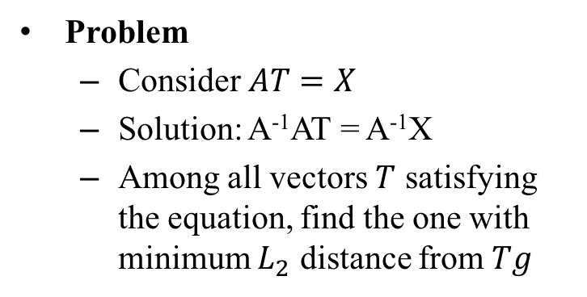





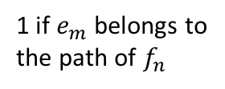
RESEARCH METHOD
$$f_{1}$$
$$f_{2}$$
. . .
$$f_{n}$$
X
$$e_{1}$$
A
Problem
  Consider $AT=X$
  Solution: A⁻¹AT = A⁻¹X
  Among all vectors $T$ satisfying the equation, find the one with minimum $L_{2}$ distance from $Tg$
$$e_{2}$$
.
.
.
$$e_{m}$$
Tg
minimize $\left|\left|T−Tg\right|\right|$
s.t.
$$\left|\left|AT−X\right|\right|is minimized$$
Gravity (prior) for $f_{n}$
1 if $e_{m}$ belongs to
the path of $f_{n}$
The amount of traffic passing through $e_{m}$

Slide 4
IMPACT
Algorithm for traffic flow inference
Algorithm for traffic analysis
Finding top-k flows in a given routing scenario
Dynamic resource allocation in software defined networks
3D images reconstruction for medical images

Slide 5
CHALLENGES
Routing matrix is binary and sparse
Routing matrix size is proportional to number of flows (which are in millions)
The number of variables (flows) is higher than number of equations (edges)
Infinitely many solutions

Slide 6
Novelty of Approach
z
The answer space is a plane
Gravity is a point outside the plane
The perpendicular line from the point to the plane is the optimal solution
The optimal values on the sides can be computed independently
Needs the transformation of the variables
A*T=X
Tg
x
y

Slide 7
EXPERIMENT PLAN
Gravity
QP
Graph
Flows
Calculates gravity based on first and last links
Graph with edge flow information
Uses specialized quadratic programming in solving the problem utilizing the underlying sparseness
Output the complete flow vector

Slide 8
EXPECTED OUTCOMES AND DELIVERABLES
Faster signal reconstruction algorithm
Faster algorithms in 3D images reconstruction
Threshold based algorithms for faster approximate 3D images
Time guarantees on algorithms and error guarantees

Slide 9
Project Timeframe and Budget
Project Duration: 1.5 Year
Year 1: Design of algorithms, implementations of algorithms, testing for accuracy, testing for scalability
Year 1.5: Design of algorithms for similarity joins, implementation and testing
Estimated cost: $60k (2 GRA)

Slide 10
Finding the Closest Point to a Prior in Large-scale Sparse Binary Under-determined Systems
Dr. Gautam Das
email: gdas@uta.edu

Slide 11
The Problem, Need and Industrial Relevance
3D image reconstruction from a 2D image
3D X-Ray images could help a doctor in determining the shape and size of a tumor. Current techniques can only reveal 2D images in an X-Ray form MRI Scan

Slide 12
Project Goals and Objectives
Given any prior, vector P, 3D image reconstruction from a set of 2D images.

Slide 13
Impact of work proposed or already performed
Generalizability of the proposed algorithm
  Traffic Matrix Computation
  Traffic Analysis in P2P
  Binary Linear Equation Solution in an under determined systems
  3D image reconstruction

